Slide 1

Predicting Stocks with Machine Learning
Matthew Smith & Sintia Stabel
IST 707

Slide 2
Disclaimer
The models and algorithms explained in this presentation are not intended as professional investment advice and should not be taken as recommendations for future investments.

Slide 3
Introduction
Many factors can influence the rise and fall of stock prices
The top 20 hedge funds in the world reported an average return of 21.15%
Algorithmic trading became widely adopted in the early 2000s
There is no “Holy Grail” system
Machine learning in becoming increasingly popular among the largest trading institutions and retail traders

Slide 4

Problem Statement
Machine learning and AI have made enormous strides in predicting the future price of stocks
The “human” element, and other socio-economic forces make the task of predicting stock prices difficult
This presentation explores how various ML models can serve as a tools to provide an edge to traders and investment enthusiasts alike

Slide 5
ABOUT THE DATA
`Datetime`: date-time group if the observation
`Open`: the opening price based on the set ticker interval (‘1m’, ‘60m’, etc.)
‘High’: the high price based on the set ticker interval
‘Low’: the low price for the interval
‘Close’: the closing price on the set ticker interval
‘Adj Close: the closing price after adjustments for all applicable splits and dividend distributions.
‘Volume’: number of shares at closing
ORIGINAL
TIME SERIES DATA

Slide 6
K Means
ResULTS and SPECIFIC TRANSFORMATIONS FOR TRAINING MODEL

Slide 7
LSTM
ResULTS and SPECIFIC TRANSFORMATIONS FOR TRAINING MODEL

Slide 8
KNN
ResULTS and SPECIFIC TRANSFORMATIONS FOR TRAINING MODEL

Slide 9
SVM
ResULTS and SPECIFIC TRANSFORMATIONS FOR TRAINING MODEL

Slide 10
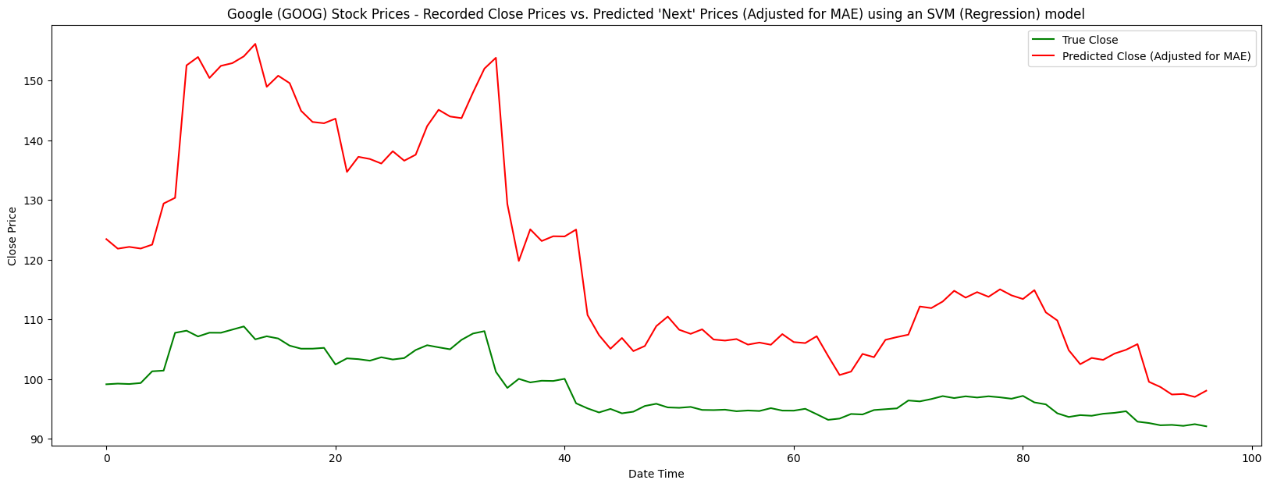

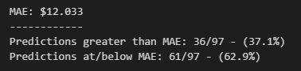
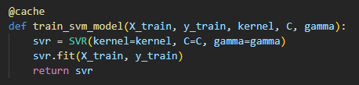
Support Vector Machine (SVM)
however, does not seem to handle predictions on the ‘amount’ of rise and fall
interesting that the error appears to level out further down the line. possibly due to the nature of the market at the time?
appears to follow general path of ‘true’ data

Slide 11
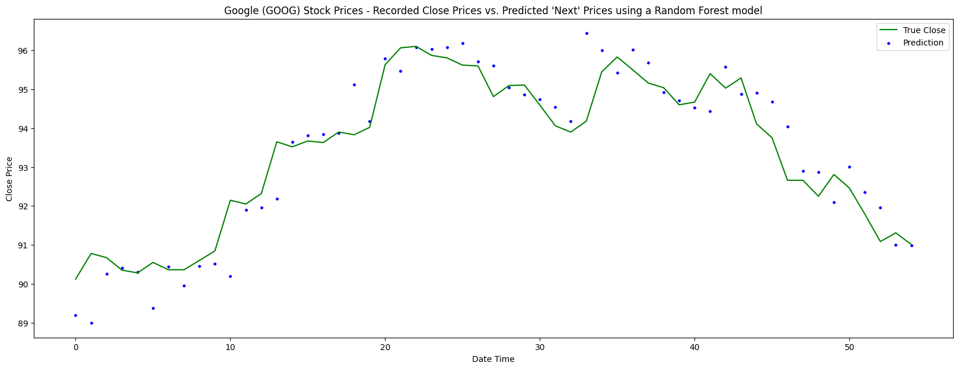
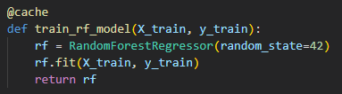
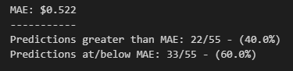
RANDOM FOREST
appears to follow general path of ‘true’ data
interestingly, the error appears to shrink the further to the right on the timeline the model predicts

Slide 12
CONCLUSION

Slide 13
QUESTIONS?

